Slide 1

GRAPH THEORY AND ITS APPLICATIONS
Dr. Arti Arya
Department of Computer Science & Engineering

Slide 2

GRAPH THEORY and its APPLICATIONS
Graph Isomorphism
Dr. Arti Arya
Department of Computer Science & Engineering

Slide 3
Graph Theory and its Applications Acknowledgement
The slides are prepared by Dr. Surabhi Narayan and a lot of inputs are added by Dr. Arti Arya. The sources of the information other than text book is mentioned wherever used.

Slide 4

Graph Theory and Its Applications Graph Isomorphism
Two graphs G and G’ are stb isomorphic to each other if
there is a 1-1 correspondence between their vertices and edges such that the incidence relationship is preserved.
The necessary conditions for two graphs to be isomorphic are:
Both must have the same number of vertices
Both must have the same number of edges
Both must have equal number of vertices with the same degree and a 1-1 correspondence between vertices

Slide 5
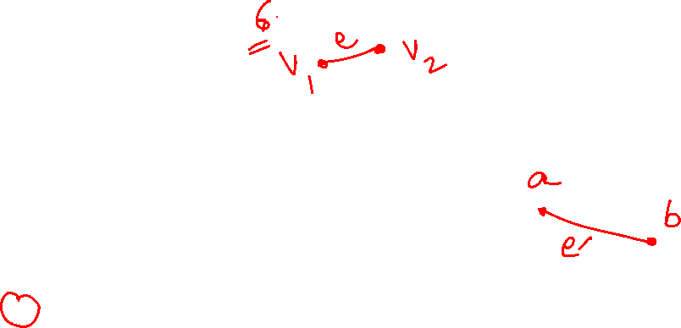
Graph Theory and its Applications Graph Basics
Graph Isomorphism:
Two graphs are equivalent ( or called isomorphic), if they have identical behavior in terms of graph-theoretic properties.
Suppose that edge e is incident on vertices v1 and v2 in G; then the corresponding edge e′ in G′ must be incident on the vertices v′1 and v′2 that correspond to v1 and v2 , respectively.

Slide 6
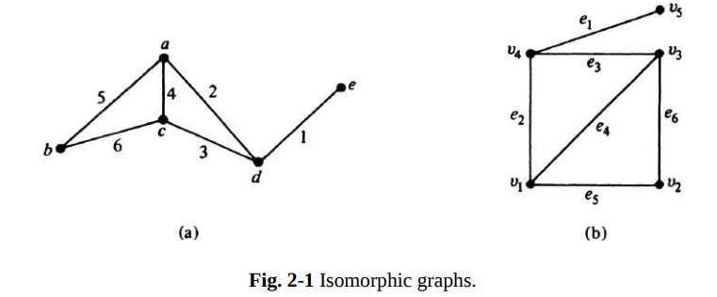

Graph Theory and its Applications Graph Isomorphism:
The vertices a, b, c, d, e correspond to v1 , v2 , v3 , v4 , and v5 , respectively.
The edges 1, 2, 3, 4, 5, and 6 correspond to e1 , e2 , e3 , e4 , e5 , and e6 , respectively

Slide 7






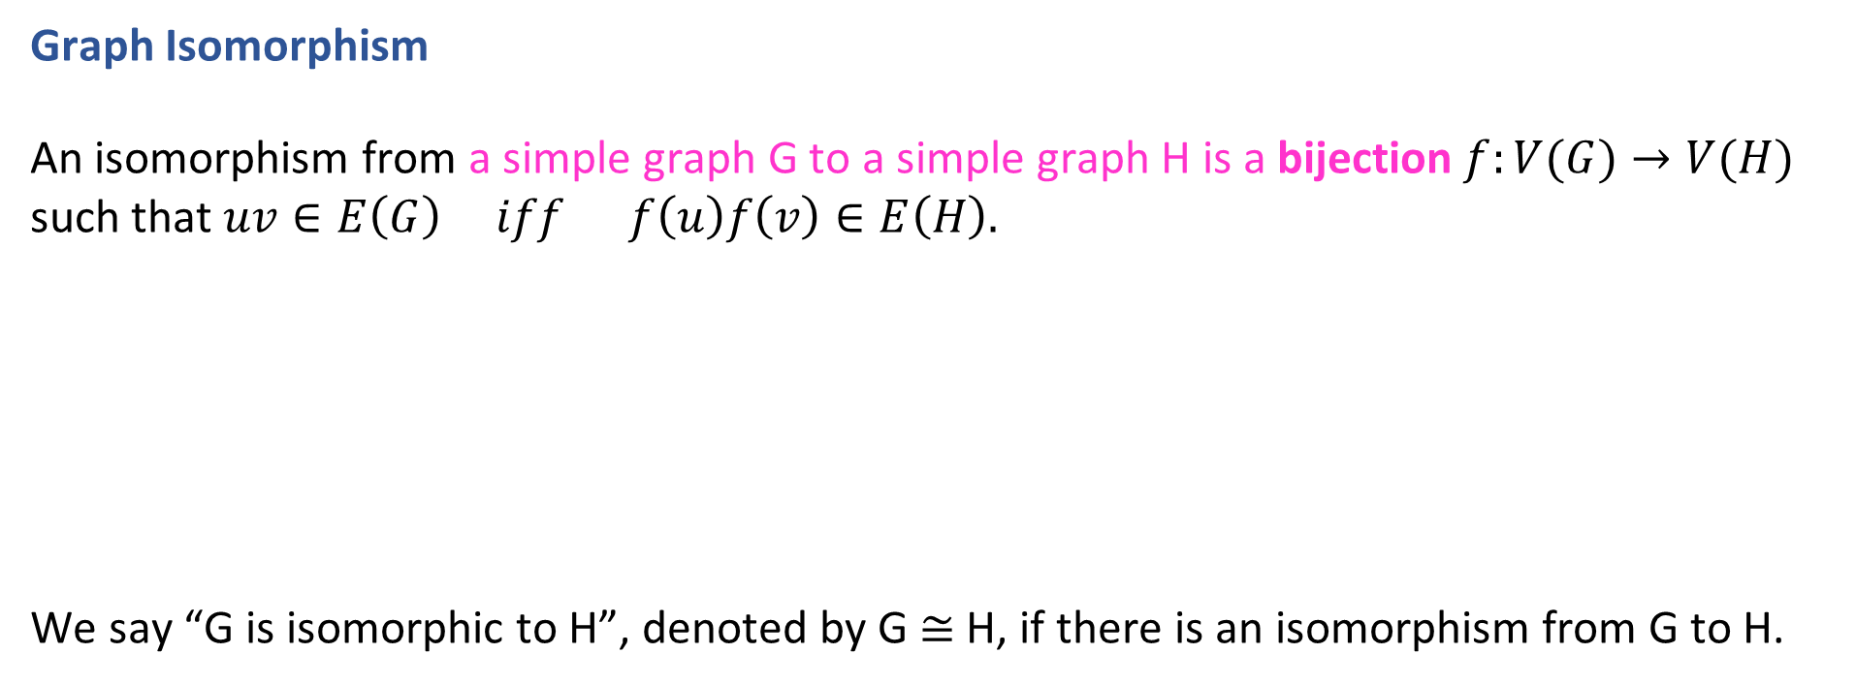
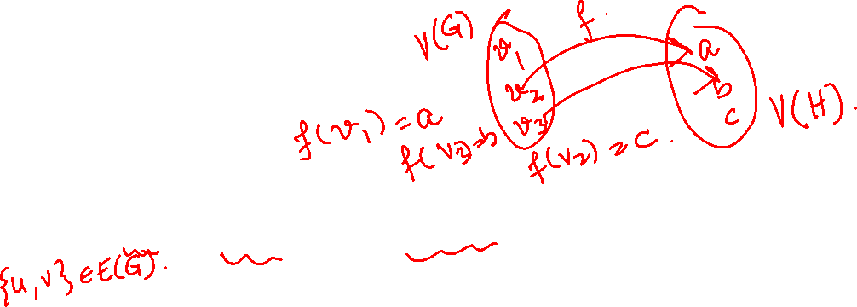
Graph Theory and its Applications Graph Basics
Graph Isomorphism
An isomorphism from a simple graph G to a simple graph H is a bijection $f:V(G)→V(H)$ such that $uv∈E\left(G\right) iff f\left(u\right)f\left(v\right)∈E\left(H\right).$
We say “G is isomorphic to H”, denoted by G ≅ H, if there is an isomorphism from G to H.
G
H

Slide 8
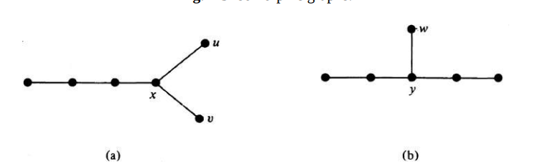
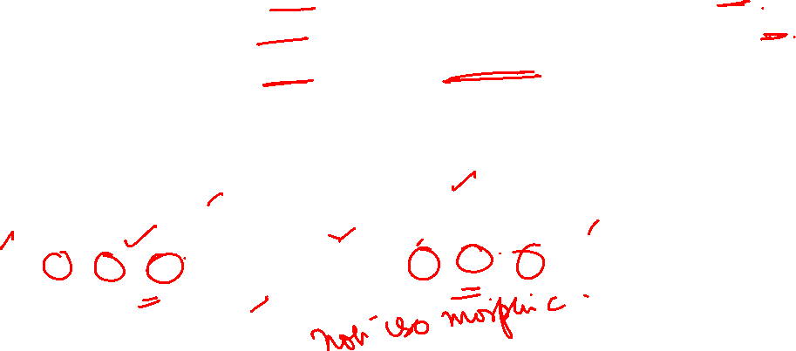
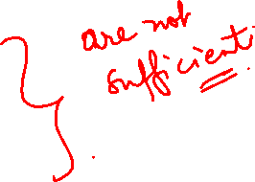
Graph Theory and its Applications Graph Basics
Graph Isomorphism
Two isomorphic graphs must have
The same number of vertices.
The same number of edges.
An equal number of vertices with a given degree.
All 3 conditions are satisfied, yet they are not isomorphic.
If the graph in Fig. (a) were to be isomorphic to the one in (b), vertex x must correspond to y, bcoz there are no other vertices of degree three.
Now in (b) there is only one pendant vertex, w, adjacent to y, while in (a) there are two pendant vertices, u and v, adjacent to x.
However, these conditions are by no means sufficient.

Slide 9
Graph Theory and its Applications Graph Isomorphism
w
Correspondence between the two Graphs:
The two graphs satisfy all 3 necessary conditions, yet they are not isomorphic.
If the two graphs were to be isomorphic then the vertex ‘x’ must correspond to ‘y’.
The Graph (b) has only one pendant vertex ‘w’ adjacent to ‘y’ whereas the Graph (a) has two pendant vertices adjacent to ‘x’

Slide 10
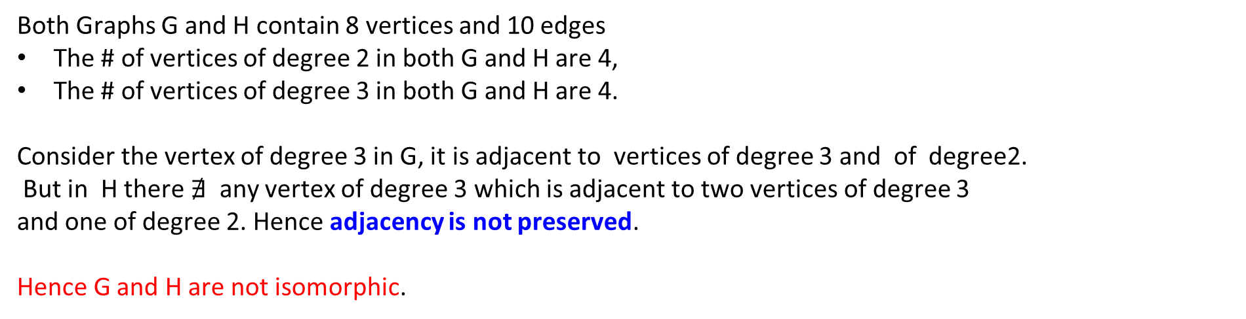
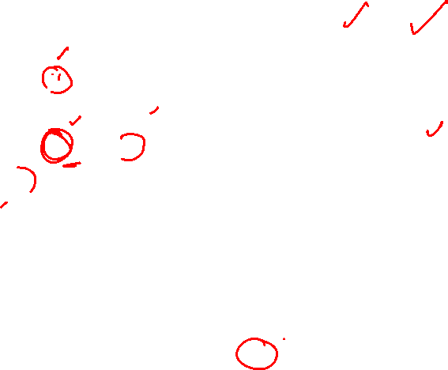
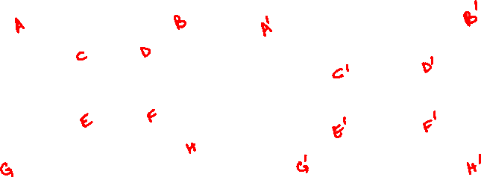
Graph Theory and its Applications Isomorphic Graphs
Find if the two graphs are isomorphic
Graph G
Graph H
Both Graphs G and H contain 8 vertices and 10 edges
The # of vertices of degree 2 in both G and H are 4,
The # of vertices of degree 3 in both G and H are 4.
Consider the vertex of degree 3 in G, it is adjacent to vertices of degree 3 and of degree2.
But in H there $∄$ any vertex of degree 3 which is adjacent to two vertices of degree 3
and one of degree 2. Hence adjacency is not preserved.
Hence G and H are not isomorphic.

Slide 11
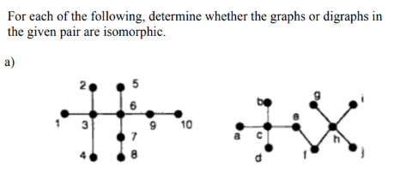


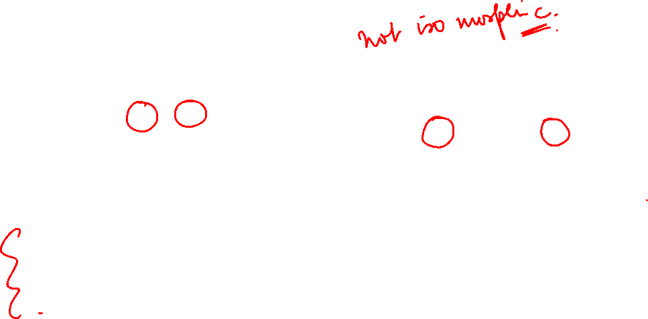
Graph Theory and its Applications Isomorphic Graphs

Slide 12
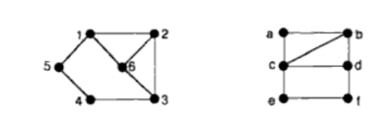

Graph Theory and its Applications Isomorphic Graphs

Slide 13
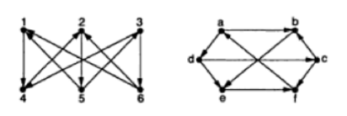
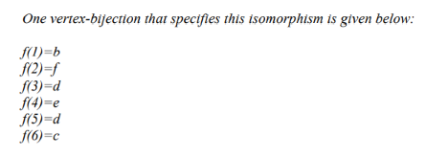

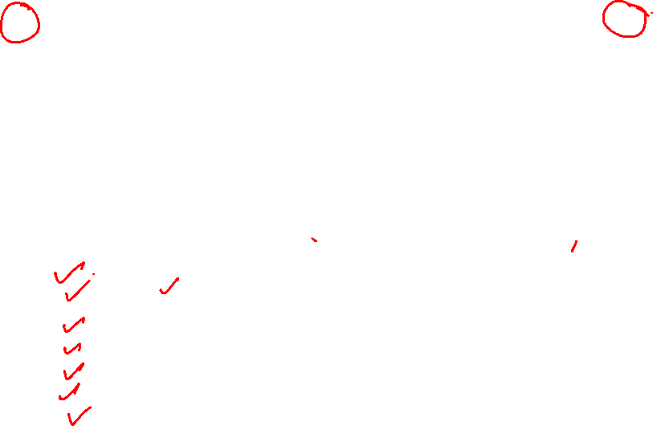
Graph Theory and its Applications Isomorphic Graphs

Slide 14

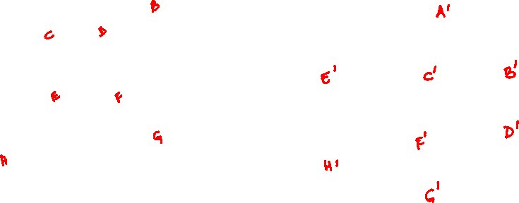
Graph Theory and its Applications Isomorphic Graphs
Graph G
Graph H
Find if the two graphs are isomorphic

Slide 15
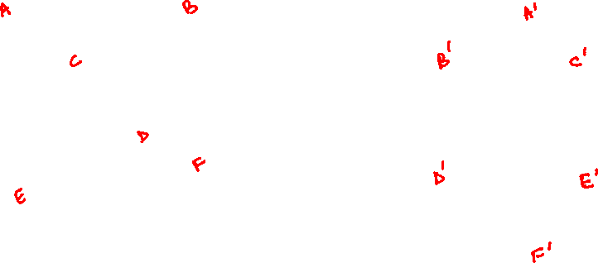
Graph Theory and its Applications Isomorphic Graphs
Graph H
Graph G
Find if the two graphs are isomorphic

Slide 16
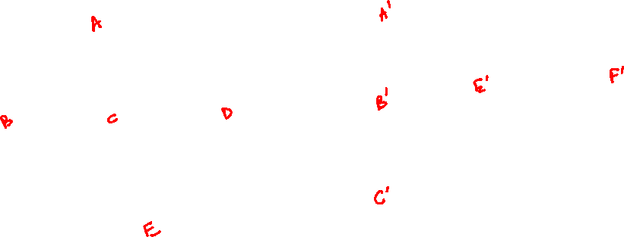
Graph Theory and its Applications Isomorphic Graphs
Graph H
Graph G
Find if the two graphs are isomorphic

Slide 17
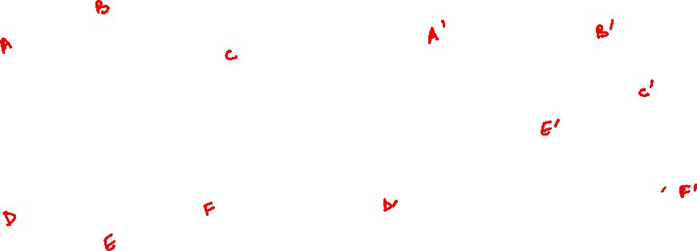
Graph Theory and its Applications Isomorphic Graphs
Graph H
Graph G
Find if the two graphs are isomorphic

Slide 18
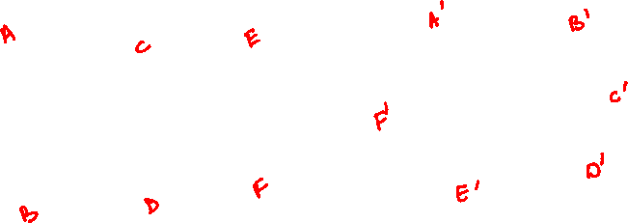
Graph Theory and its Applications Isomorphic Graphs
Graph H
Graph G
Find if the two graphs are isomorphic

Slide 19
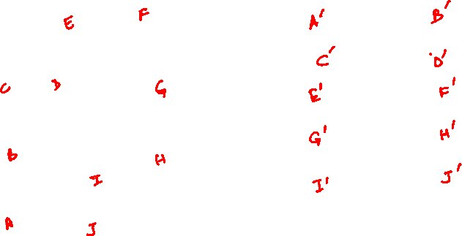
Graph Theory and its Applications Isomorphic Graphs
Graph H
Graph G
Find if the two graphs are isomorphic

Slide 20
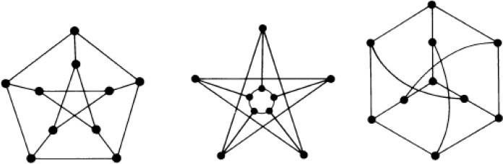
Graph Theory and its Applications Isomorphic Graphs
Are the graphs isomorphic

Slide 21
THANK YOU
Dr. Arti Arya
Department of Computer Science &Engineering
artiarya@pes.edu

Slide 22
GRAPH THEORY and its APPLICATIONS
Course Instructor: Dr. Arti Arya
Department of Computer Science & Engineering

Slide 23
GRAPH THEORY and its APPLICATIONS
Planar Graphs
Dr. Arti Arya
Department of Computer Science & Engineering

Slide 24
Graph Theory and its Applications Acknowledgement
The slides are prepared by Dr. Surabhi Narayan and a lot of material is added by Dr. Arti Arya. The sources of the information other than textbook is mentioned wherever used. The material is prepared from various resources like universities from abroad and India and also internet resources.

Slide 25
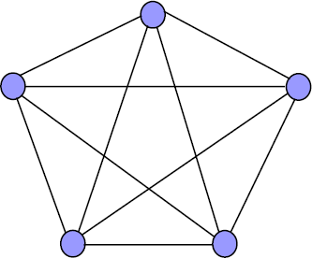
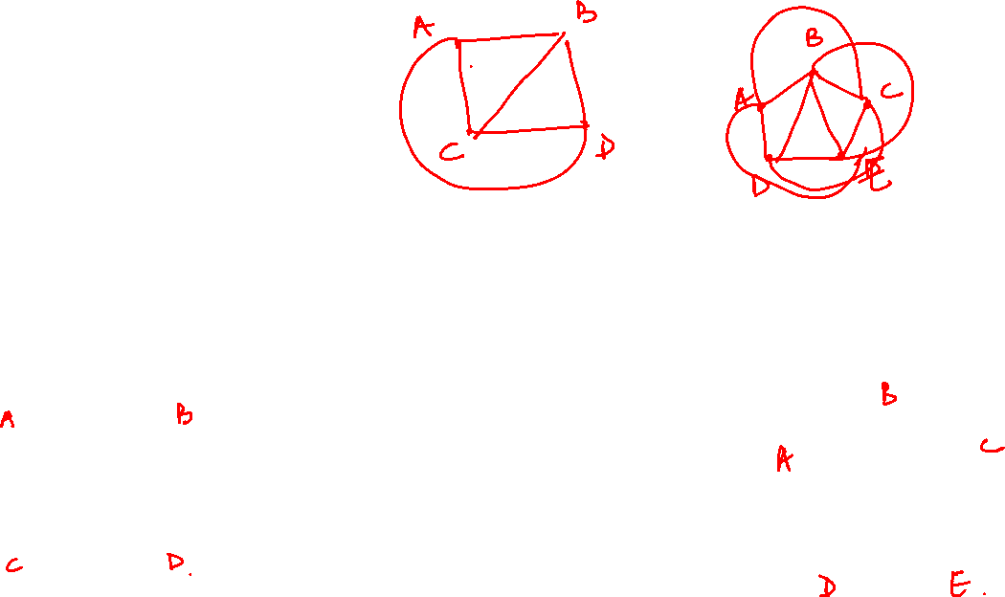
Graph Theory and its Applications Planar Graphs
Planar Graph
A graph G is planar if it can be drawn on a plane surface with no two edges intersecting
G is stb embedded in the plane.
A graph that can’t be drawn on a plane surface without a crossover between the edges is called a non-planar graph.
K3
K4
K5

Slide 26
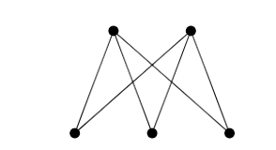
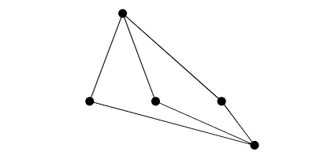
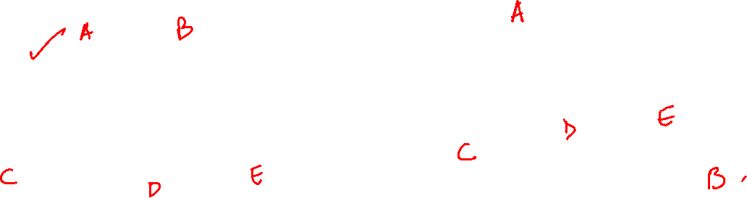
Graph Theory and its Applications Planar Graphs
Planar Graph
A graph G is planar if it can be drawn on a plane surface with no two edges intersecting
G is stb embedded in the plane.
A graph that can’t be drawn on a plane surface without a crossover between the edges is called a non-planar graph.

Slide 27






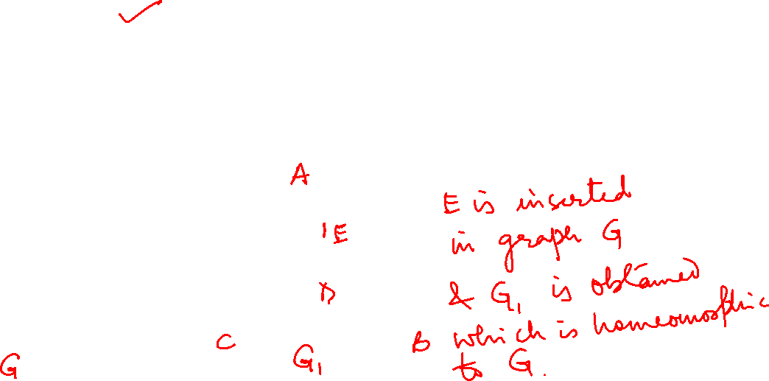
Graph Theory and its Applications Planar Graphs
Homeomorphic Graph
Two graphs G1 and G2 are stb homeomorphic if one of these can be obtained from the other by the process of
(a) insertion of new vertices (of degree 2) into its edges
(b) merging of adjacent edges.
A
D
B
C

Slide 28
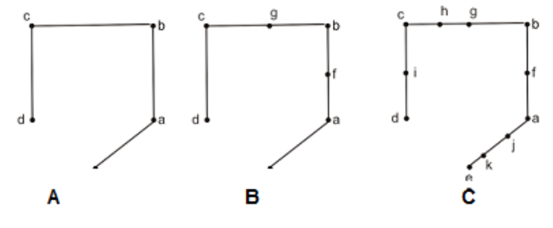
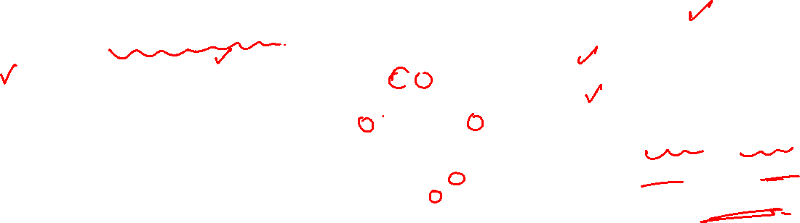
Graph Theory and its Applications Planar Graphs
Homeomorphic Graph
Two graphs G1 and G2 are stb homeomorphic if one of these can be obtained from the other by the process of
(a) insertion of new vertices of degree two into its edges
(b) merging of adjacent edges.
A and B are homeomorphic
A and C are homeomorphic
B and C are homeomorphic
But A & B or A & C are not isomorphic or even B and C are also not isomorphic.

Slide 29

Graph Theory and its Applications Planar Graphs
Circuit Layout Design: Planar graphs are commonly used in the design and optimization of electronic circuits. The arrangement of components and connections in a circuit can be modeled as a planar graph. Algorithms that work with planar graphs can help in minimizing wire crossovers, reducing signal interference, and improving circuit performance.
2. Geographical Information Systems (GIS): Planar graphs are used in GIS applications to represent and analyze geographic data. Road networks, utility networks, and transportation systems can be modeled as planar graphs. AI algorithms can be applied to planar graphs to optimize route planning, network connectivity, and resource allocation.
3. VLSI Design: Very Large Scale Integration (VLSI) design involves creating integrated circuits with a large number of components. Planar graphs are used to model the layout of these components, including their connections and placements. AI techniques can aid in optimizing the layout for better performance, power efficiency, and manufacturability.
4. Map Labeling and Graph Drawing: In cartography, planar graphs are used to solve map labeling problems where labels need to be placed on a map without overlapping. Graph drawing algorithms that work with planar graphs can help generate visually appealing and informative maps.

Slide 30

Graph Theory and its Applications Planar Graphs
5. Scheduling and Timetabling: Planar graphs can be used to model scheduling and timetabling problems where events, tasks, or resources need to be allocated efficiently. AI algorithms can optimize schedules to minimize conflicts, delays, or resource utilization.
6. Constraint Satisfaction Problems: Planar graphs can be used as a basis for solving constraint satisfaction problems (CSPs) in AI. Many real-world problems can be formulated as CSPs, and planar graph-based techniques can help in solving them efficiently.
7. Network Design and Communication: Planar graphs can represent communication networks, such as wireless sensor networks or communication channels. AI algorithms can optimize network design, routing, and communication protocols to ensure efficient and reliable data transmission.
8. Game AI and Pathfinding: In video games, planar graphs are used for pathfinding algorithms that guide characters or agents through a game environment. AI algorithms can efficiently navigate the graph to find optimal or near-optimal paths.
These are just a few examples of how planar graphs play a role in AI applications. Their inherent structure and properties make them valuable tools for modeling, analyzing, and optimizing various real-world systems and problems.

Slide 31
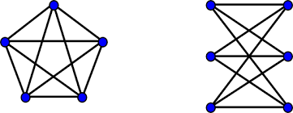

Graph Theory and its Applications Planar Graphs
Kuratowski’s theorem
A necessary and sufficient condition for a graph G to be planar is that G does not contain K₅ or K_{3,3} as a subgraph or any subgraph homeomorphic to either of these.

Slide 32
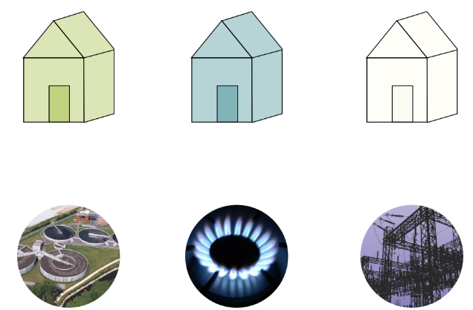
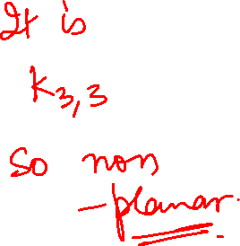
Graph Theory and its Applications Planar Graphs
Three houses in a small village all need to be supplied with water, gas and electricity. Can you make all the connections between the houses and the supplies without having any 2 cable crossing?

Slide 33
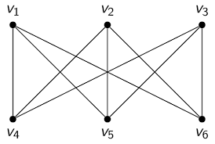
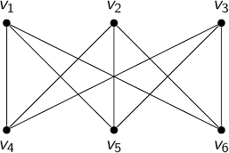
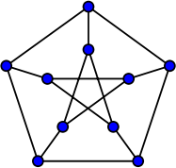




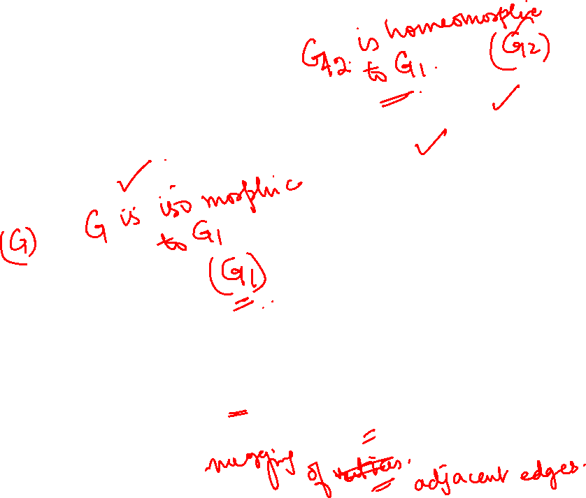
Graph Theory and its Applications Planar Graphs
Show that Petersen graph is a non-planar Graph
V10
V7
V9
V8
V2
V5
V6
V4
V9
V8
V10
V7
V9
V8
V1
V3
V10
V7

Slide 34
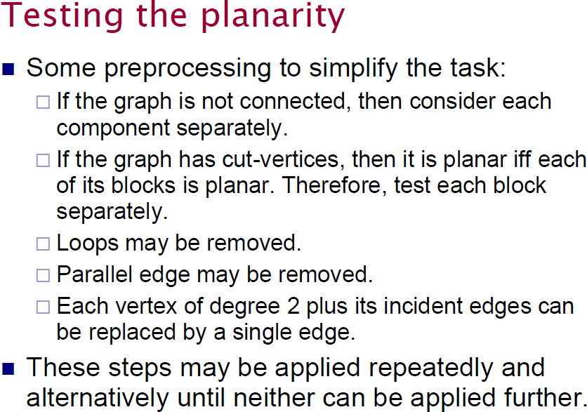
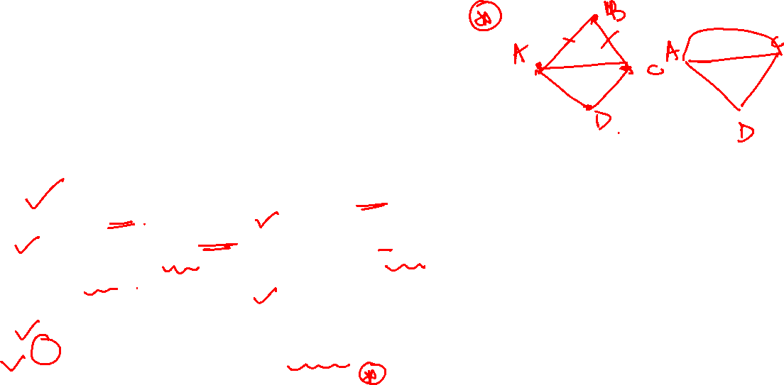
Graph Theory and its Applications Planar Graphs( Elementary reduction Method)

Slide 35
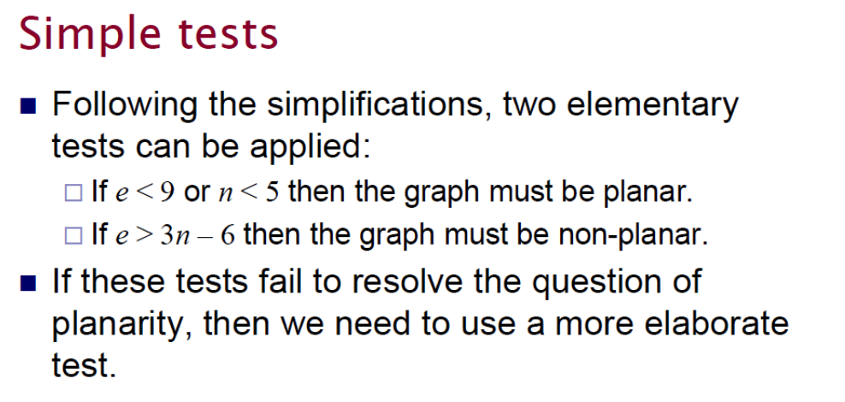
Graph Theory and its Applications Planar Graphs

Slide 36
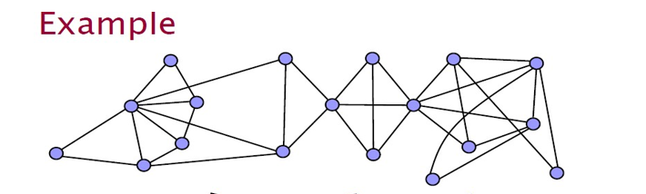

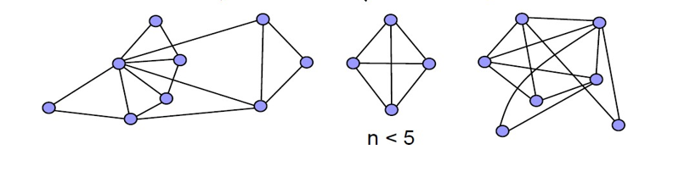
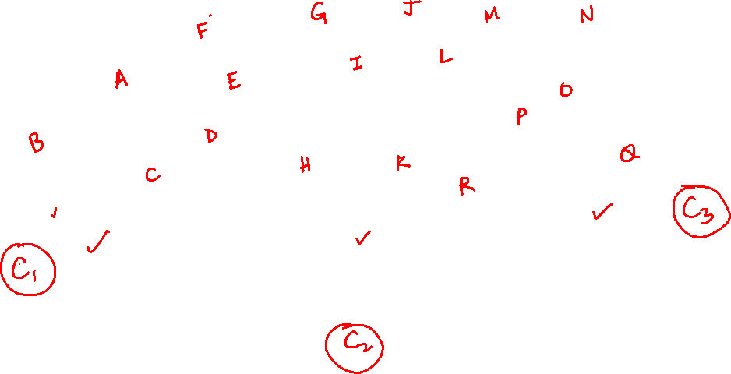
Graph Theory and its Applications Planar Graphs

Slide 37
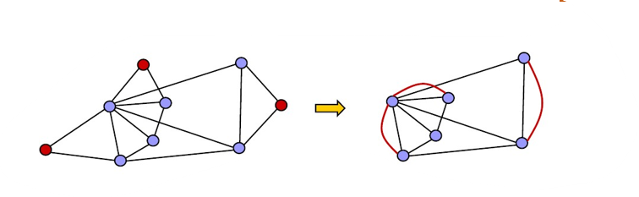
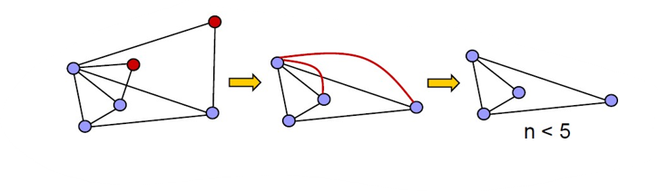

Graph Theory and its Applications Planar Graphs

Slide 38
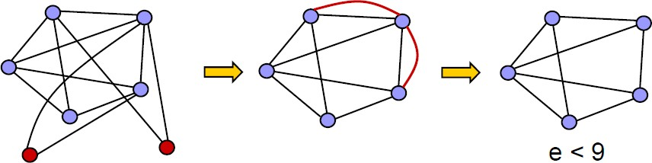
Graph Theory and its Applications Planar Graphs

Slide 39
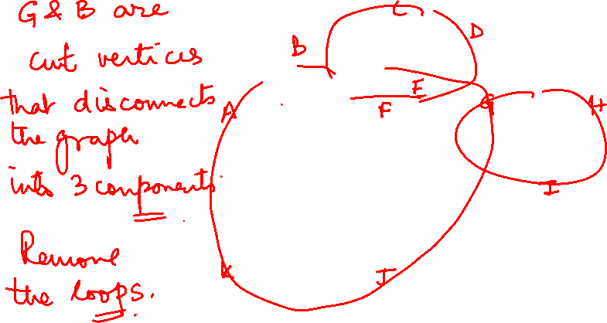
Graph Theory and its Applications Planar Graphs

Slide 40
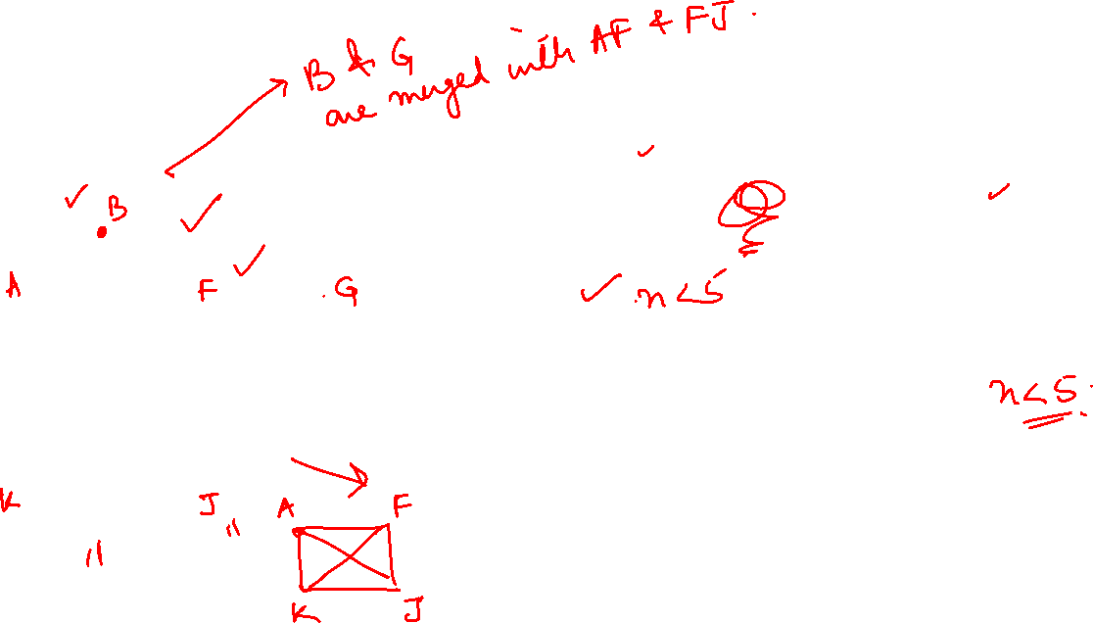
Graph Theory and its Applications Planar Graphs
G3
G2
G1

Slide 41
Graph Theory and its Applications Planar Graphs
G3
G2
G1

Slide 42
Graph Theory and its Applications Planar Graphs
G3
G2
G1
G is planar

Slide 43
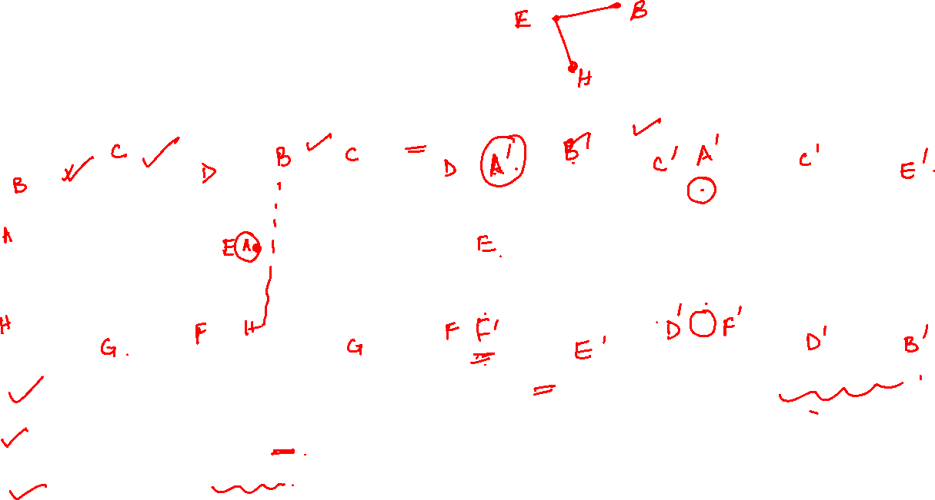
Graph Theory and its Applications Planar Graphs
Using Kuratowski’s theorem, prove that G is non planar
G
G1
K3,3
G2
G1 is a subgraph of G
G2 is homeomorphic to G1 G2 is isomorphic to K3,3
Hence G is non-planar

Slide 44


Graph Theory and its Applications Planar Graphs
Faces (regions)
A planar representation of a graph divides the plane into a number of connected regions: faces.
Each face is bounded by edges.
One of the faces encloses the graph: exterior face.

Slide 45

Graph Theory and its Applications Planar Graphs
Euler’s Theorem on Planar Graphs
If a connected planar graph G has ‘n’ vertices, ‘e’ edges and ‘r’ regions then
n – e + r =2
If G= (V,E) is a connected simple graph with |V| = n, |E| = e > 2 and r regions, then e >= 3r/2 and e <= 3n - 6
R4
n = 7
e = 9
r = 4
n – e + r =2 7-9+4=2
R1
R2
R3

Slide 46


Graph Theory and its Applications Planar Graphs
Euler’s Theorem on Planar Graphs
If a connected planar graph G has ‘n’ vertices, ‘e’ edges and ‘r’ regions then
n – e + r =2
If G= (V,E) is a connected simple graph with |V| = n, |E| = e > 2 and r regions, then e >= 3r/2 and e <= 3n - 6

Slide 47

Graph Theory and its Applications Planar Graphs
Show that kuratowski’s 1st graph (K5) is nonplanar
Solution :
e=10
n = 5
For planar graph e <= 3n -6
10 <= 9 false hence K5 is nonplanar

Slide 48

Graph Theory and its Applications Planar Graphs
Verify Euler’s formula for planar graphs for the given graph

Slide 49
Graph Theory and its Applications Planar Graphs
A connected planar graph has 9 vertices having degrees, 2,2,2,3,3,3,4,4,5. How many edges and faces(regions)are there?

Slide 50
THANK YOU
Dr. Arti Arya
Department of Computer Science &Engineering
artiarya@pes.edu

